Slide 1
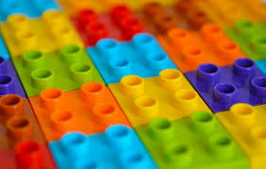
CO2 – Polymeric Materials

Slide 2
Course plan
Introduction:
Types – organic, inorganic, thermoplastics, thermosetting plastics, homo and copolymers, stereoregular polymers.
Degree of polymerisation, average molecular weights.
Polymerisation reactions – chain, condensation – one example each.
Morphology – amorphous and crystalline states.
Properties of polymers:
Thermal properties – glass transition– factors influencing glass transition temperature, determination by DSC.
Mechanical properties – stress-strain analysis, critical radius of curvature for flexible electronics.
Electrical properties:
Insulating properties - dielectric breakdown.
Aging of polymer insulations - discharges in voids, electrical treeing.
Degradation of polymers - thermal and photochemical – significance in polymer electronics.
Additives for polymer electronics – plasticisers, stabilisers, functional additives – metal deactivators, antistatic agents, flame retardants.

Slide 3

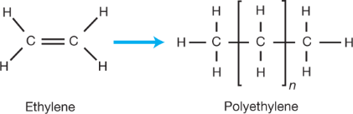
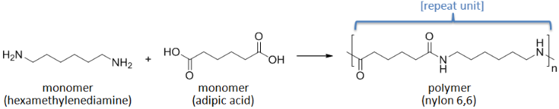
Introduction
Polymer is a macromolecule of very high molecular weight.
Monomers are the building blocks – Repeating units
Combine with each other to form polymer.
Monomers have two bonding sites:
( =, = , - OH, - COOH, - NH₂ )
Polymerization is conversion of monomer into polymer.
Functionality: Total no. of bonding sites or functional groups present in monomer.

Slide 4
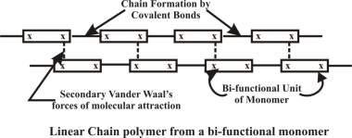
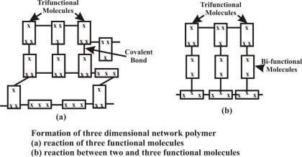
Functionality

Slide 5
Classification of Polymers
Nature of Repeat Units
Nature of backbone chain
Structural Characteristics
Sterochemistry
Molecular (Functional Group) Classification
Physical properties
End Uses
Polymerisation Process (Chain or Step Growth)
All highlight certain aspect or property of the polymer.

Slide 6
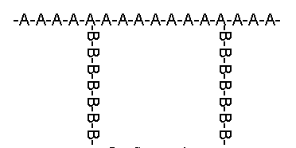
Nature of Repeat Units
Homopolymer- A-A-A-A-A-A-A-A-A-A-A-
(identical repeat units)
Copolymer - Different repeat units
Alternating Copolymer- A-B-A-B-A-B-A-B-A-B
Block Copolymer - AAAAAAAA-BBBBBBBBB
Random Copolymer- AA-B-A-B-B-A-A-A-B-B-A
Graft Copolymer-

Slide 7
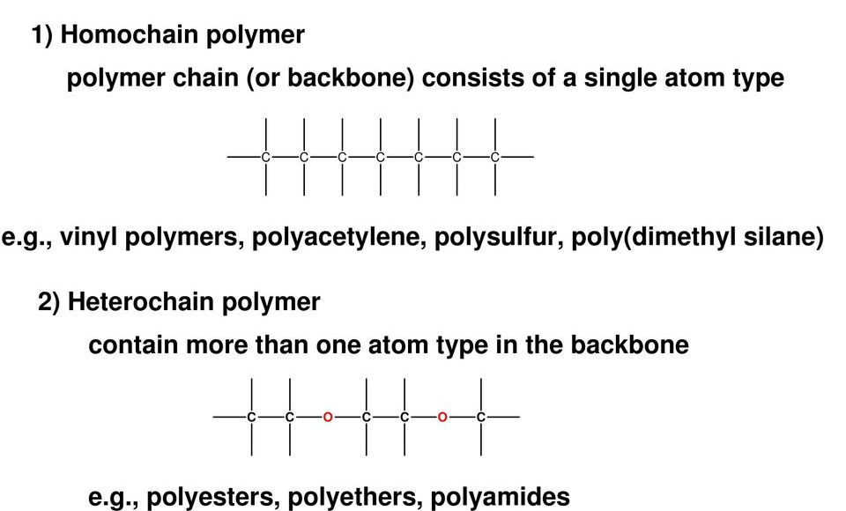
Nature of Backbone Chain

Slide 8
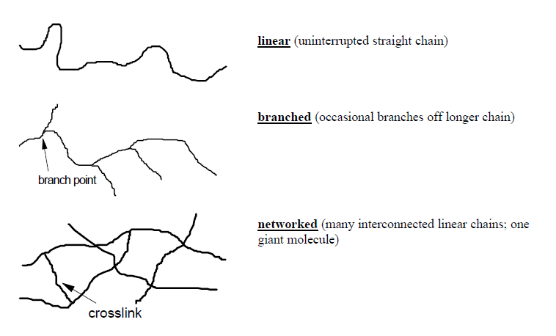
Structural characteristics
closely related to materials properties

Slide 9
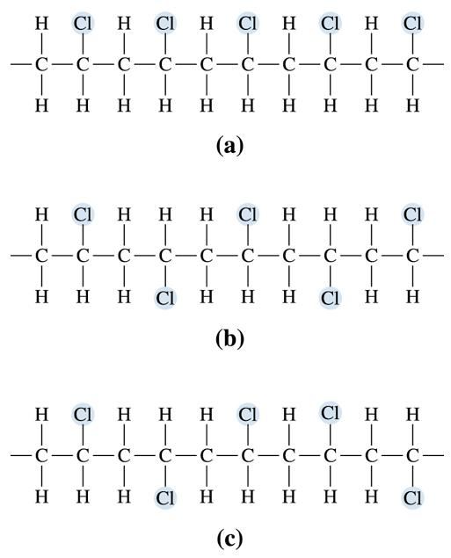
Stereochemistry
Three possible arrangements of nonsymmetrical monomers:
Isotactic
side groups in same side
(b) Syndiotactic
side groups in alternating side
(c) Atactic
side groups is random

Slide 10
Polymer Families
Polyolefins: made from olefin (alkene) monomers
Polyesters, Amides, Urethanes, etc.: monomers linked by ester, amide, urethane or other functional groups
Natural Polymers: Polysaccharides, DNA, proteins

Slide 11
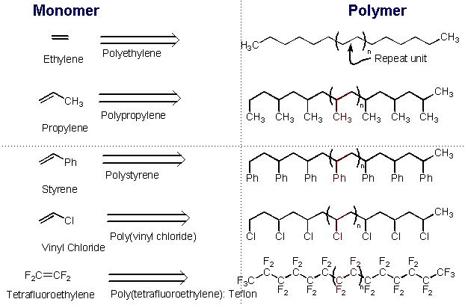
Common Polyolefins

Slide 12
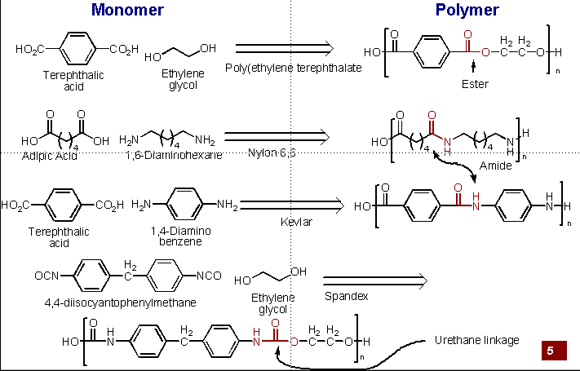
Polyesters, Amides, and Urethanes

Slide 13
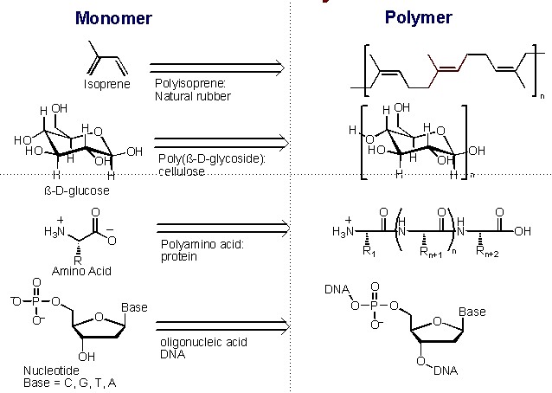
Natural Polymers

Slide 14
Physical Property Classifications
Looking at polymers as materials rather than from a chemical point of view, several classifications are widely used.
Temperature
1) Thermoplastics (plastics) — linear, or branched architecture can be melted and reformed on heating. Soluble in organic solvents
Amorphous—no ordered structure-soften over a relatively wide temperature range (always lower than T_{m}) known as the glass transition (T_{g}). Above these temperatures, polymers are liquids
Eg. polystyrene and poly(methyl methacrylate).
b) Semi-crystalline—composed of microscopic crystallite domains of crystalline structure. Can be ordered.
Semi-crystalline polymers have true melting temperatures (T_{m}) at which the ordered regions break up and become disordered.
Eg: polyethylene. Fibers (nylon, PET polyester)

Slide 15
2) Thermosets—(resins)—massively cross-linked
very rigid; degrade on heating. Insoluble in solvents.
Usually synthesised in mold, then shaped by machining (grinding, drilling). E.g (tires, rubber bands)
3) Elastomers (rubbers) — moderately cross-linked can be stretched and rapidly recover their original dimension
4)Thermoplastic elastomers: Elastic polymers that can be melted (soles of shoes)
5) Dendrimers—multiple branched—multiple consecutive (regular) branches.

Slide 16
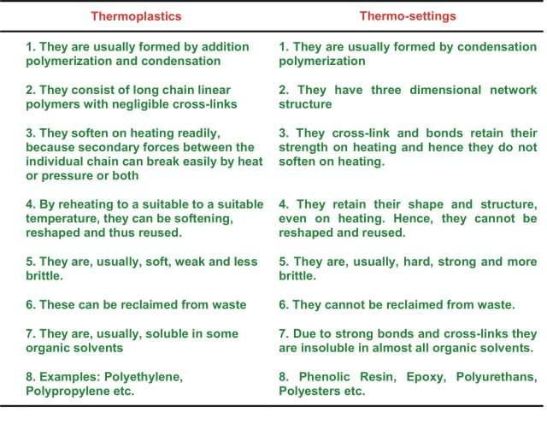
Difference Between Thermoplastics and Thermosetting Polymers

Slide 17
End Use
Rubbers:- have long range elasticity
low molecular cohesion
tensile strength 300-1000 psi (lbs/sq inch)
Natural rubber, Buna-S-butyl rubber, Silicone rubber
Plastics:- stronger than rubbers
tensile strength 4000-13000 psi (lbs/sq inch)
types -hard and stiff or soft and flexible
Polyethylene, poly vinyl chloride, Teflon
Fibers:- strongest of the three types of polymer
tensile strength 20000-150000 psi (lbs/sq inch)
Jute, Wool, Silk, Nylon-6,6
Resins:- low molecular weight polymers – adhesives
Bakelite, epoxy resin

Slide 18
Polymer Material Properties Depends on
Degree of Polymerization
Molecular Weight of the Polymer
Molecular Weight Distribution
Glass Transition Temperature
Percentage of Crystallinity
Structure and Distribution of Chain Branching

Slide 19
Molecular weight and Degree of polymerisation
Degree of polymerisation
Number of repeating unit in a polymer called as degree of polymerisation (DP). DP provides the indirect method of expressing the molecular weight and the relation is as follows;
M = DP x m
Where, M is the molecular weight of polymer, DP is the degree of polymerisation and m is the molecular weight of the monomer
DP = M / m
DP can be related to the corresponding molecular weight average by the following two equations;
M_{n} = (DP)_{n}.m
M_{w} = (DP)_{w}.m

Slide 20
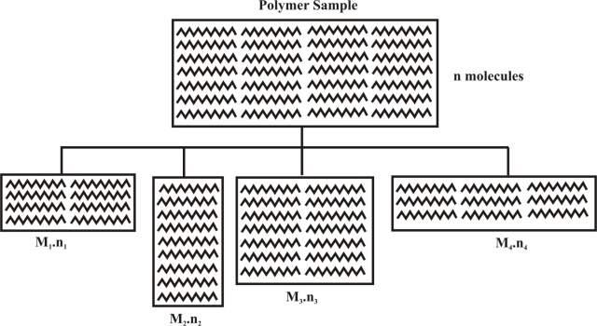
Molecular weight of Polymers
Molecular weight of polymer is the sum of atomic weights of the individual atoms that comprise a molecule. It indicates the average length of the bulk polymer chains. All polymer molecules of a particular grade do not have the exact same molecular weight. There is a range or distribution of molecular weights.

Slide 21
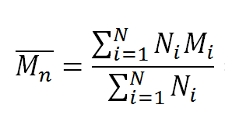
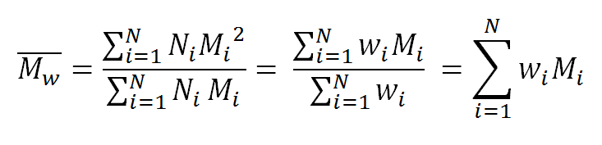
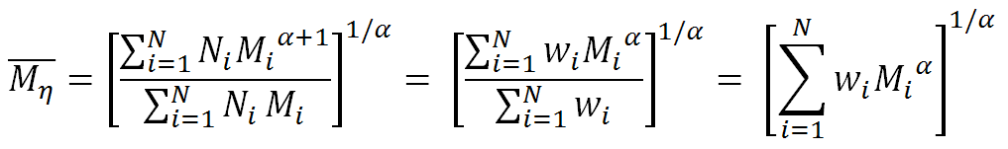
Number-average molecular weight
Weight-average molecular weight
Viscosity-Average molecular weight
Where,
n = Moles of molecules (n₁ + n₂ + n₃ + ----------n_{i}) i.e. weight (w)/molecular weight (M)
w = Weight of individual molecules (w₁ + w₂ + w₃ + ---------w_{i})
M = Molecular weight of each molecules
η = Viscosity

Slide 22
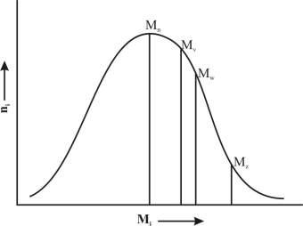
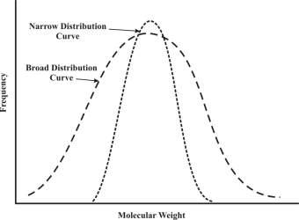
Polydispersity Index for Molecular weight of Polymers
The ratio of Mw/Mn is called as Polydispersity index (PDI) of polymer.
The narrower the molecular weight range, the closer the values of M_{w} & M_{n} and the ratio M_{w}/M_{n} may thus be used as an indication of the breadth of molecular weight range in a polymer sample.
If all the polymer molecules present have the same molecular weight, the system is monodiperse.
Polydispersity Index, PDI = M_{w} / M_{n}
Molecular Weight Distribution

Slide 23
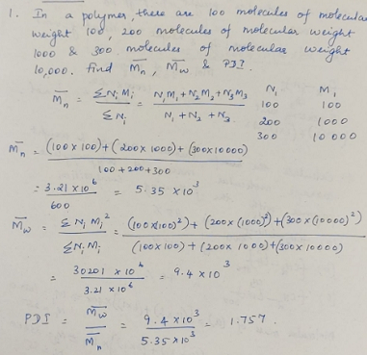

Slide 24
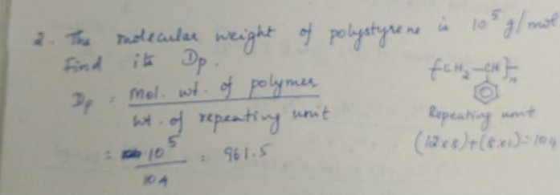

Slide 25
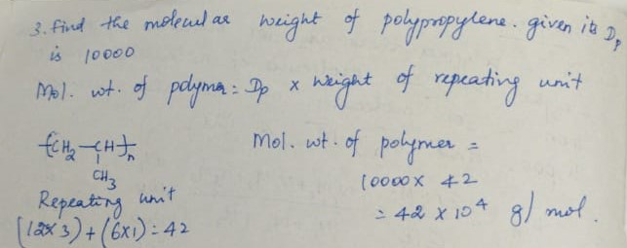

Slide 26
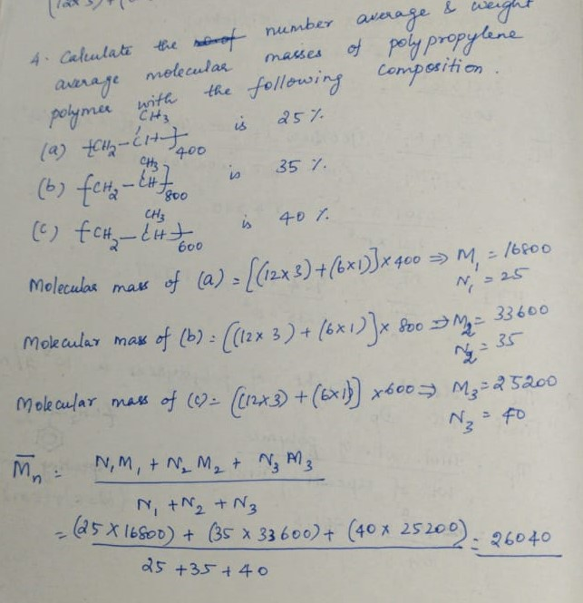

Slide 27
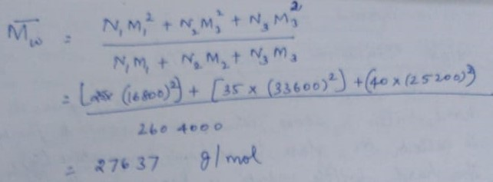

Slide 28
Practical Significance of Molecular weight of Polymers
The influence of molecular weight on the bulk properties of polyolefin's,
an increase in the molecular weight leads to
Increase in:
Melt viscosity
Impact strength
High molecular weight polymer does not crystallize so easily as lower molecular weight material crystallizes due to chain entanglement and that reflect in bulk properties of the high molecular weight polymer.
Lowers in:
Hardness, Stiffness
Softening point
Brittle point

Slide 29
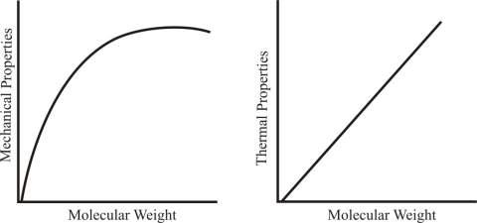
A high molecular weight polymer increases the mechanical properties.
Higher molecular weight implies longer polymer chains and a longer polymer chain implies more
entanglement thereby they resist sliding over each other.
Increasing the molecular weight and the chain length of the polymer increases impact strength.
Thermal properties can also improved by increasing the molecular weight.

Slide 30
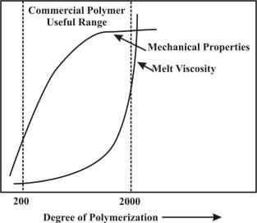
Significance of Degree of Polymerization
To bring into sharper focus the effect of molecular weight on physical properties, a more generalized form of representation is given in figure, mechanical strength is plotted against 'DP .
Threshold value (TV)) for DP – Below which polymer does not possess any strength & exists as powder or liquid resin
The knee portion of the curve at which polymer attains more or less full strength also varies from one polymer to another.
The optimum strength of most of polymers is obtained at 600, while they do not exhibit any strength below DP, 30
The useful range of DP is from 200 to 2000, which corresponds to its molecular weight 20000 to 200000

Slide 31
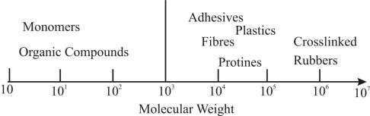
Molecular weight and Polymers

Slide 32
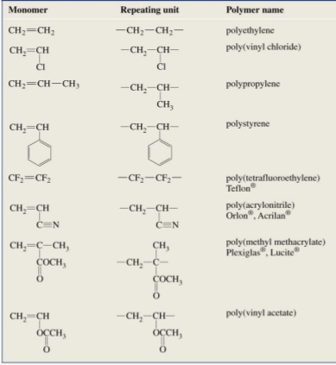
Common Polymers

Slide 33


Polymerization
In 1929 W. H. Carothers suggested a classification of polymers into two groups, addition and condensation polymers with respect to polymerization
Addition Polymerization
Condensation Polymerization

Slide 34
Difference between Addition and Condensation Polymerization
Addition Polymerization | Condensation Polymerization
Olefinic (or) Vinylic compounds undergo addition polymerization | Monomers with two or more functional groups undergo condensation polymerization
No elimination of by-products | Continuous elimination of by-products
Double-bond provides required bonding sites | Intermolecular condensation reaction
Addition of monomers takes place rapidly | Polymer chain built up is slow and step-wise
Initiators – free radicals are used | Catalysed by acids or alkali
Elemental composition of polymer is same as monomer | Elemental composition of polymer is different from monomer

Slide 35
General Mechanism of Polymerization
Two types of polymerization based on mechanism
Chain Polymerization
(i) Free-radical mechanism
(ii) Ionic mechanism
2. Step-growth Polymerization
Chain Polymerization
i) Vinyl compounds -CH₂=CHX
ii) Dienes -CH₂=CH-CH=CH₂
iii) Olefins -CH₂=CH₂
iv) Allyl compounds -CH₂=CH-CH₂X (X = -OH, -Cl, -Br, -COOH, -COOCH₃)

Slide 36
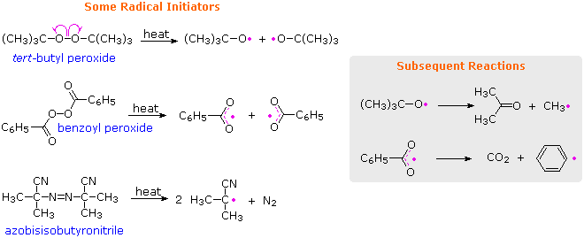

Mechanism of Chain Polymerization
Three major steps:
(i) Initiation
(ii) Propagation
(iii) Termination
Free Radical Mechanism
Initiator
Compound which is thermally unstable and decompose into products called free-radicals

Slide 37
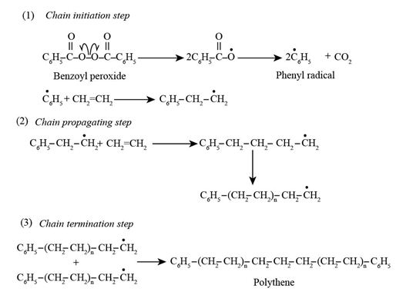

Slide 38
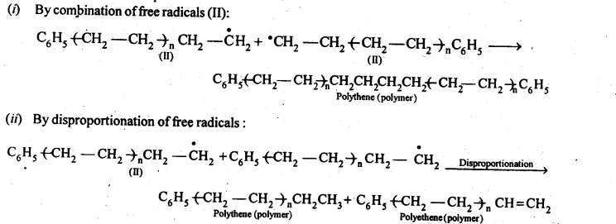
The first step of polymerisation reaction is chain initiation step. In chain initiation step, formation of phenyl free radical takes place which then react with monomer of ethene to form a bigger size free radical.
The repetition of this sequence occur in chain propagation step and
In the final termination step, formation of polythene takes place.

Slide 39
Ionic Polymerization
Cationic Polymerization:
The initiator is an acid (Lewis acids – (AlCl₃, BF₃), HCl, H₂SO₄, HNO₃) and the propagating site of reactivity (*) is a carbocation.
Eg. Homopolymerization of isobutylene
• Anionic Polymerization:
The initiator are Alkali metal (Na/K) amides, Alkali metal alkyls (n-butyl lithium) and the propagating site of reactivity (*) is a carbanion.
Eg. Co-polymerization of isobutylene with 2-methylpropene

